Slide 1
CLASSIFICATION Logistic Regression

Slide 2
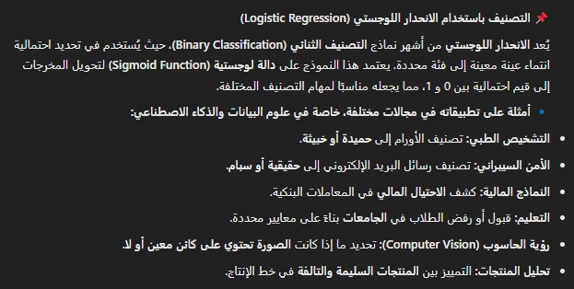






Slide 3





Slide 4
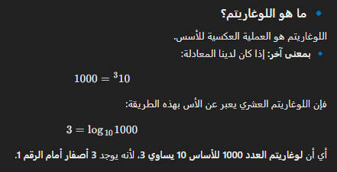






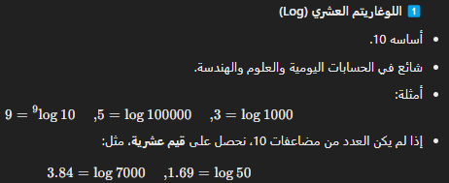
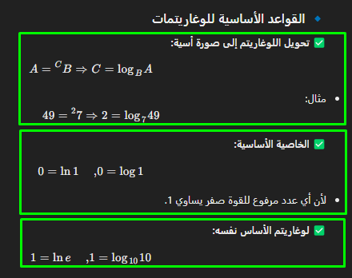

تامتيراغوللا عاونأ

Slide 5



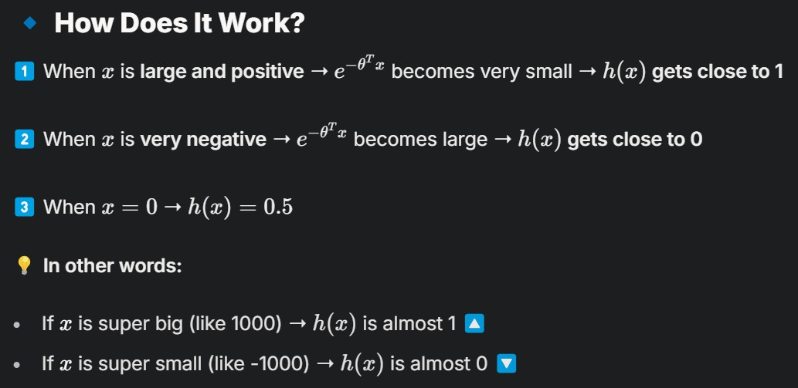


Slide 6
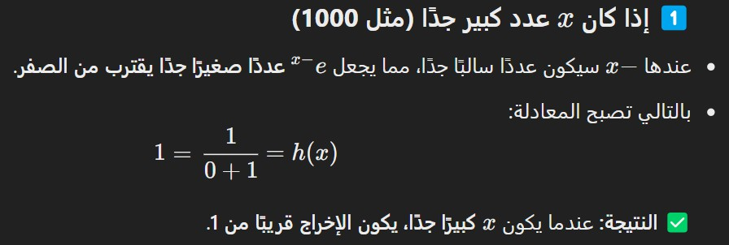
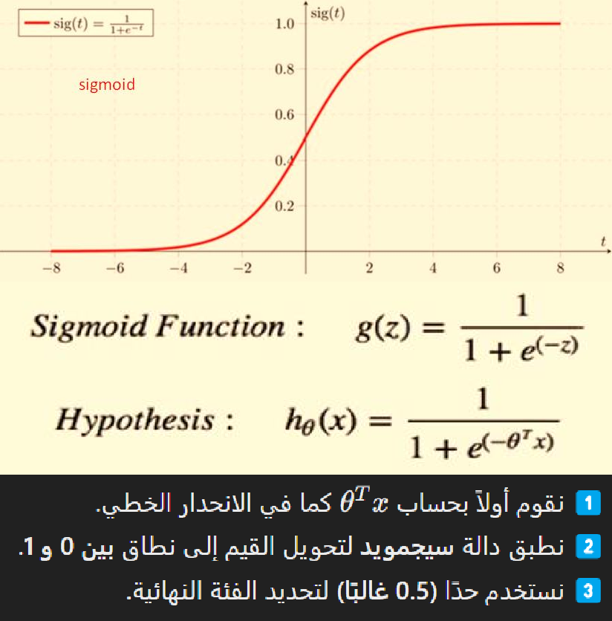
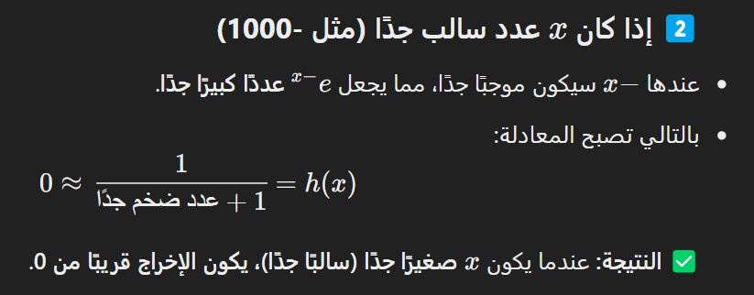
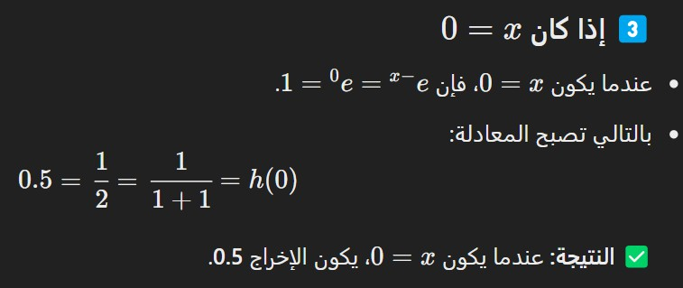

Slide 7
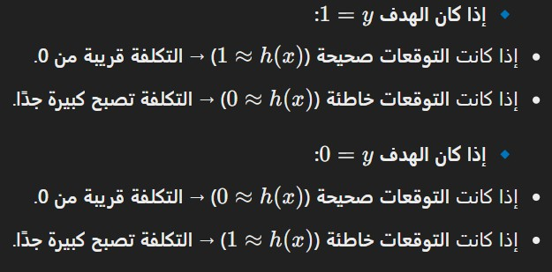

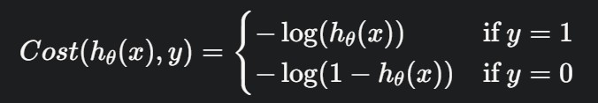


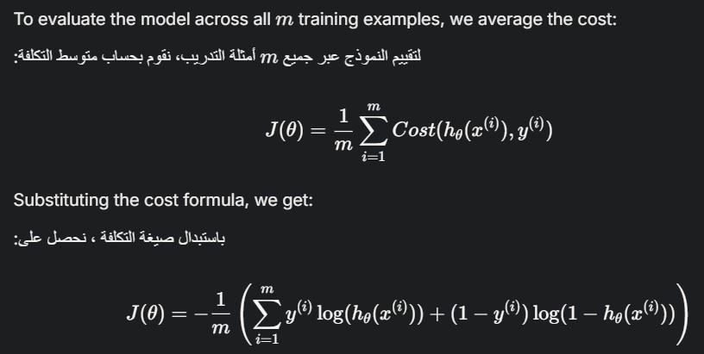
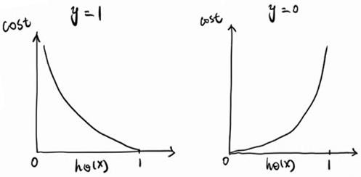


Slide 8
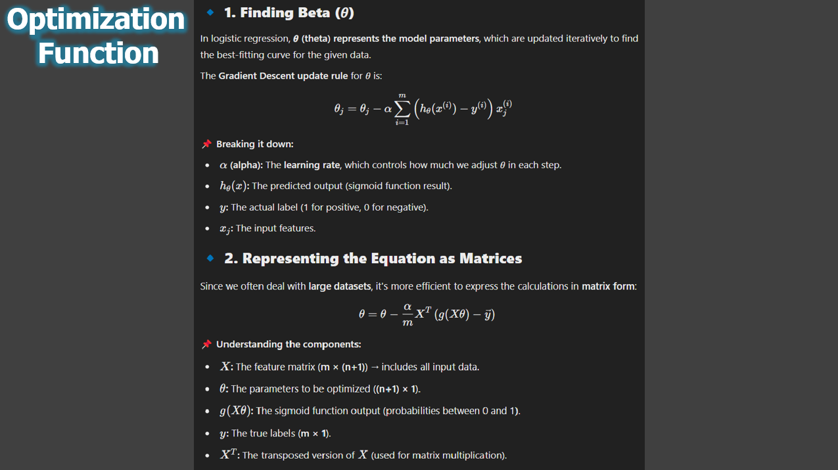

Slide 9
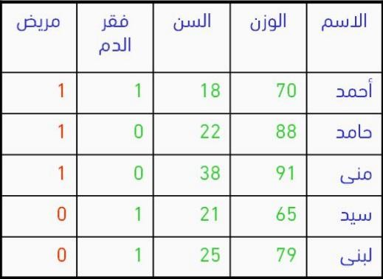
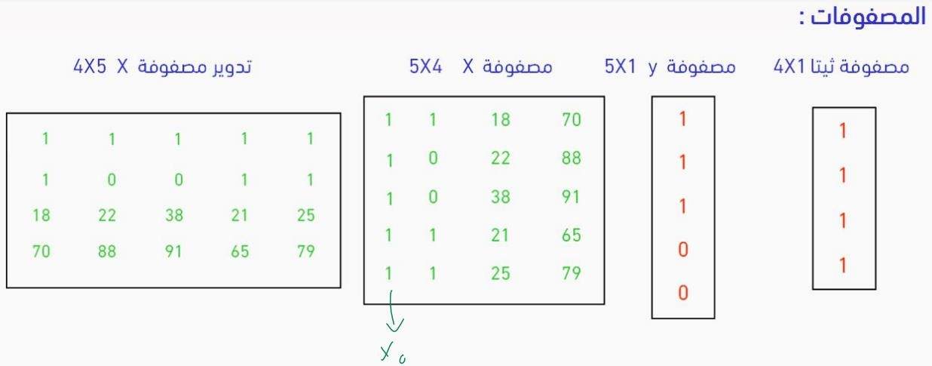
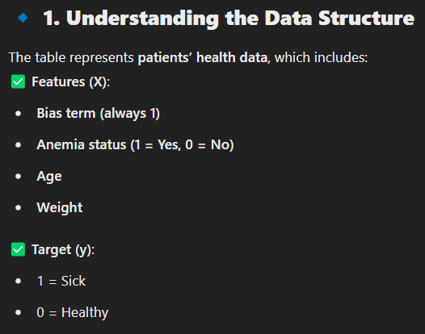
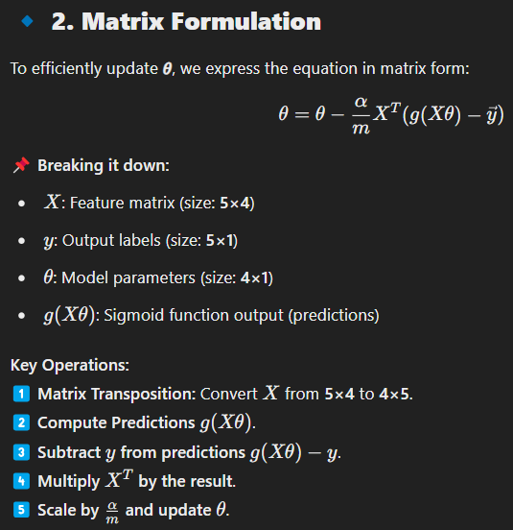
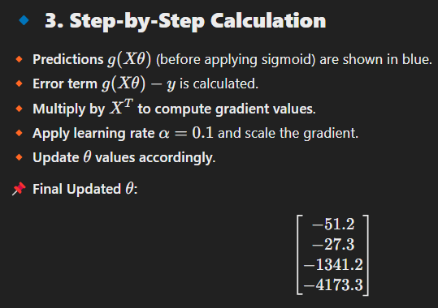

Slide 10
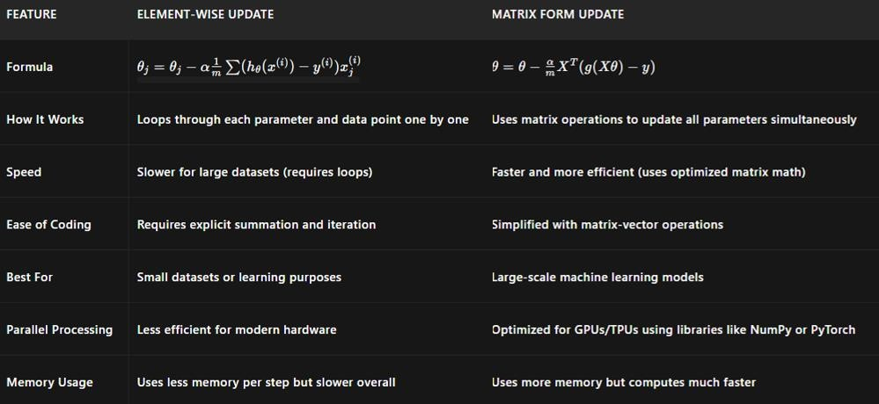


Slide 11
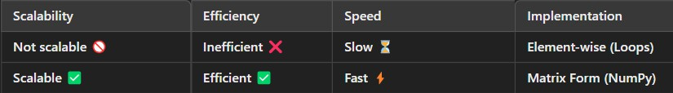

import numpy as np
# Sample data
X = np.array([[1, 18, 70], [1, 22, 88], [1, 21, 91], [1, 25, 79]]) # Features (m x n)
y = np.array([1, 0, 1, 0]) # Labels (m x 1)
theta = np.zeros(X.shape[1]) # Initialize parameters (n x 1)
alpha = 0.01 # Learning rate
m = len(y) # Number of samples
# Gradient Descent (Element-wise)
for epoch in range(100): # 100 iterations
for j in range(len(theta)): # Loop over parameters gradient = (1/m) * np.sum((X @ theta - y) * X[:, j]) theta[j] -= alpha * gradient
print("Theta (Element-wise):", theta)
# Gradient Descent (Matrix Form) for epoch in range(100):
gradient = (1/m) * X.T @ (X @ theta - y)
theta -= alpha * gradient
print("Theta (Matrix Form):", theta.flatten())

Slide 12


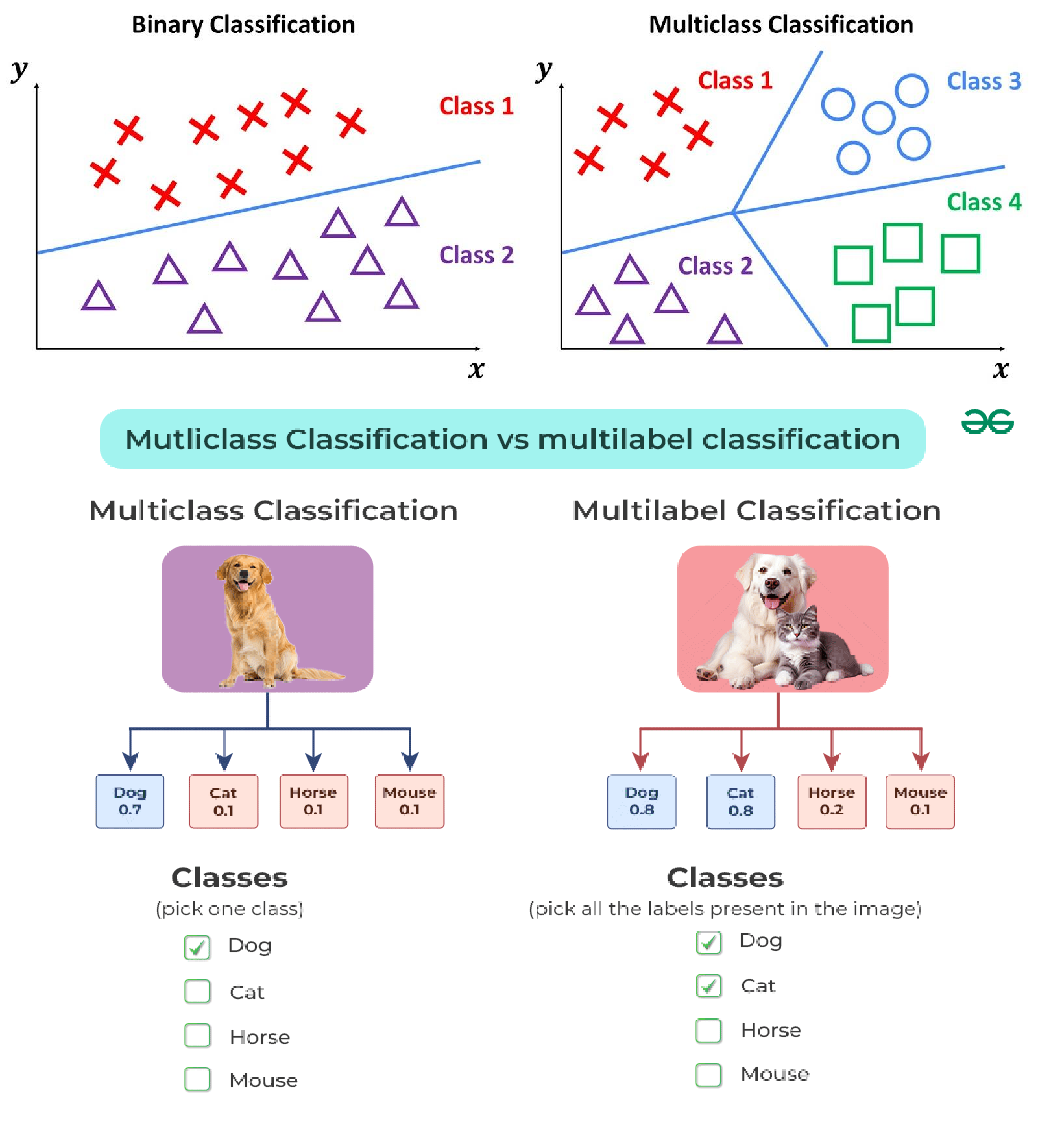




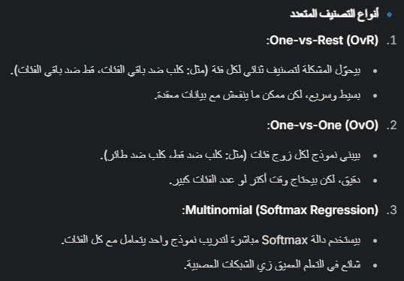

Slide 13

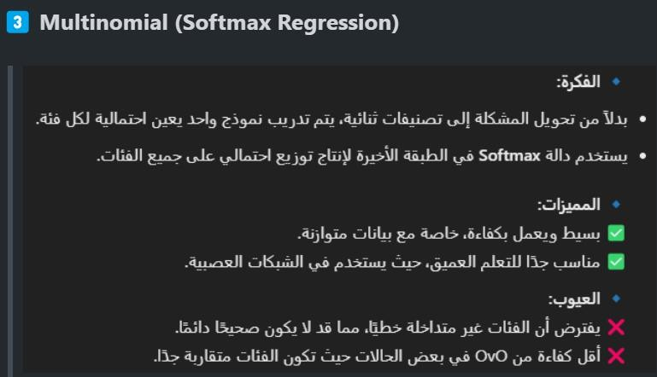
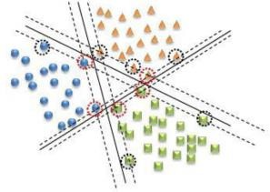

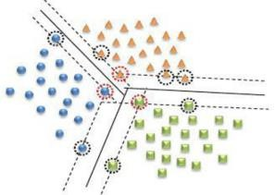
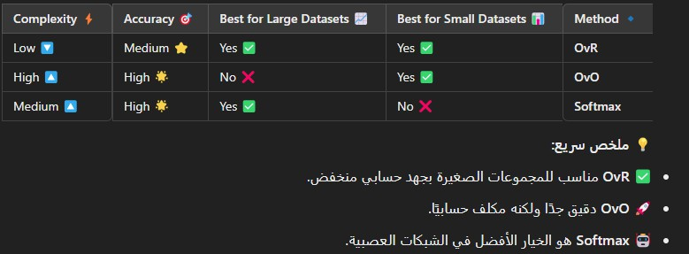
= OvA (One-vs-All)
= AvA (All-vs-All)

Slide 14
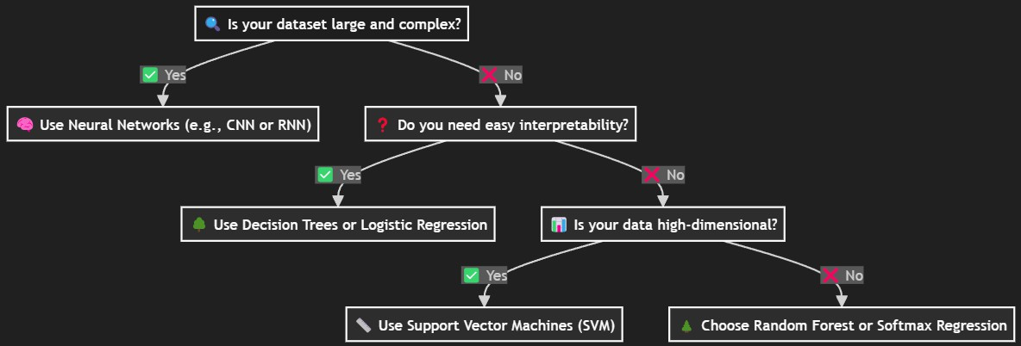


Slide 15
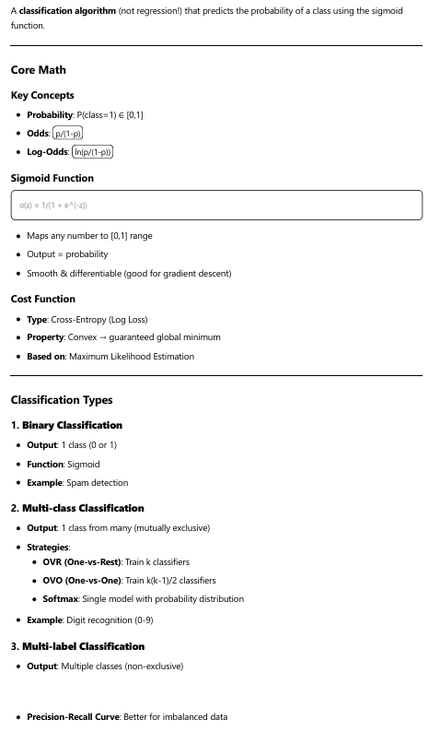
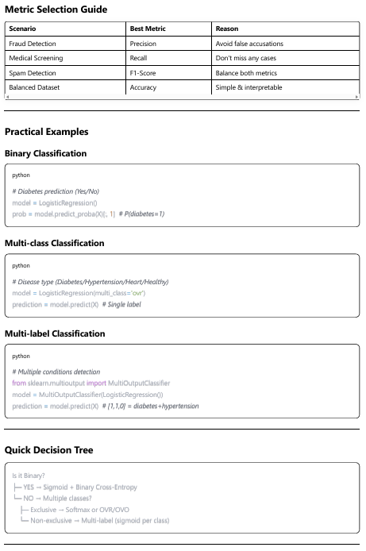
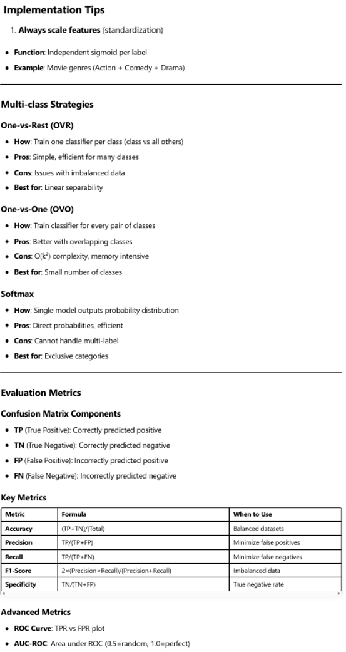
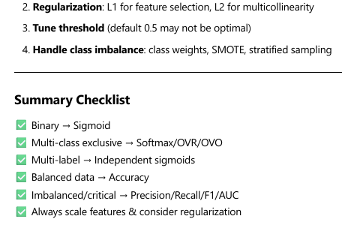
Summary

